Slide 1
SOFTWARE PROCESS DEVELOPMENT MODEL
Defines a distinct set of activities, actions, tasks, milestones, and work products that are required to engineer high-quality software .
The activities may be linear, Incremental, or Evolutionary
Prescriptive Model ( Waterfall Model,(LSM) Incremental Model(description) & RAD )
Evolutionary Process Model ( Spiral ,Prototype & Concurrent)

Slide 2
SOFTWARE PROCESS DEVELOPMENT MODEL
Customer gets to know about the software product at the end of the cycle.
One of the approaches has a high dependency on Automated tool for delivering the product at a very short span of time.
Process model used for long term projects in which high risk and many external stakeholders are involved.
One of the approach implements software in modules in upper order, one by one.
Process Model which works best for Project Managers to review the status.

Slide 3
AGILE
Quick changes , adaptability

Slide 4
AGILE SOFTWARE DEVELOPMENT MODEL
Basics of Agile Process models
Principles of Agile,
Agile Manifesto;
Agile Requirements : User stories ,Backlog Management
Agile Architecture : Feature Driven Development
Test Driven Development

Slide 5
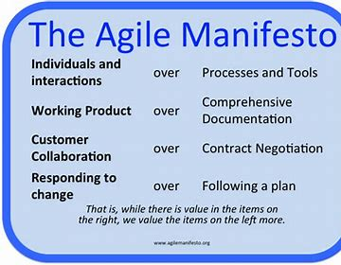
AGILE MANIFESTO

Slide 6
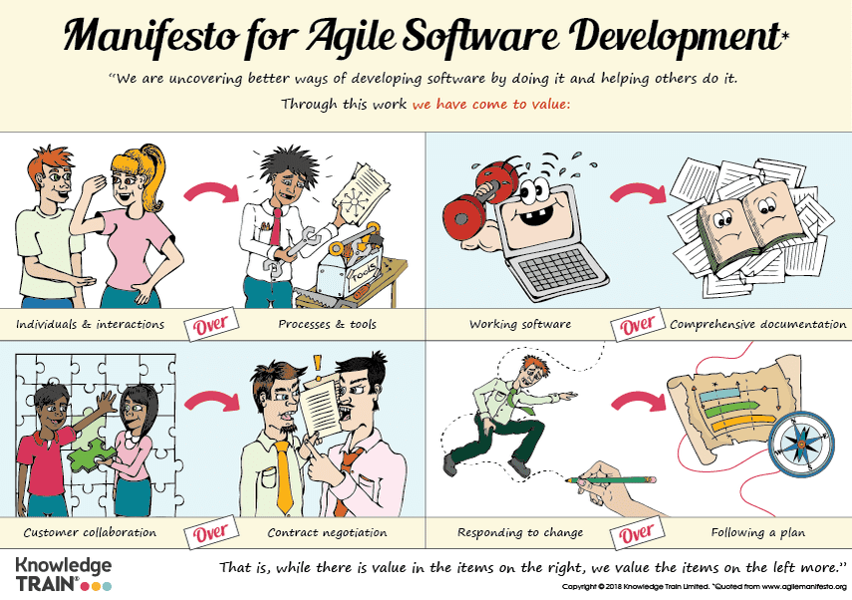

Slide 7
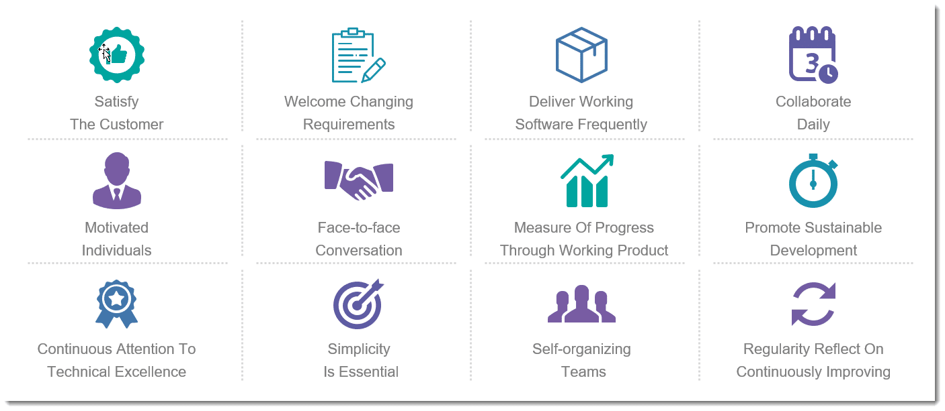
AGILE PRINCIPLES

Slide 8
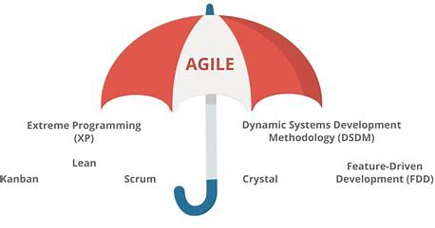
Basics of Agile Process models

Slide 9
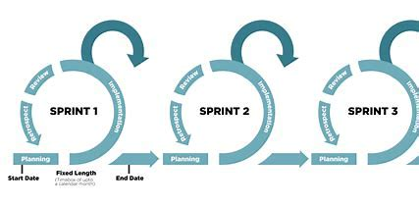
SCRUM -
SCRUM is an agile development method which concentrates specifically on how to manage tasks within a team-based development environment. Basically, Scrum is derived from activity that occurs during a rugby match. Scrum believes in empowering the development team and advocates working in small teams (say- 7 to 9 members). It consists of three roles, and their responsibilities are explained as follows:
What is a SPRINT ?

Slide 10
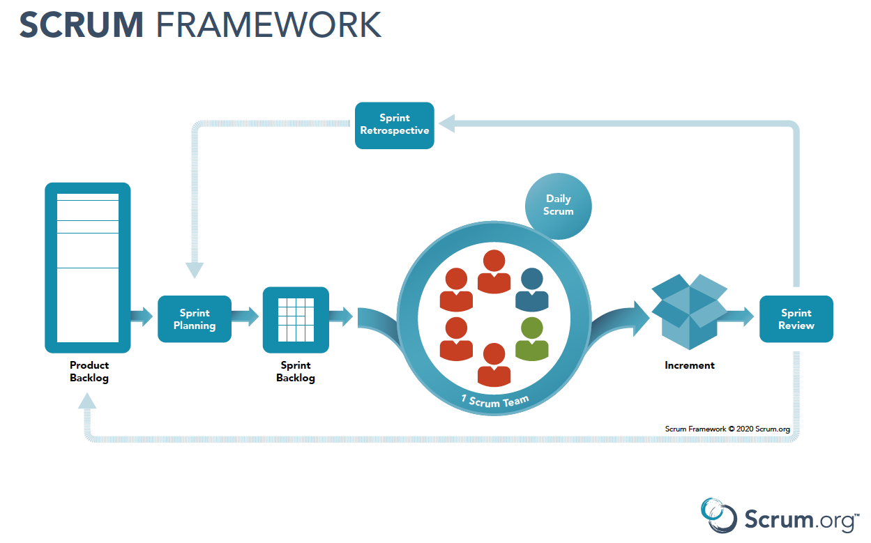

Slide 11
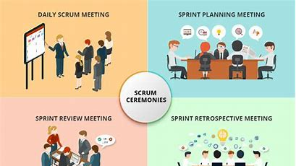

Slide 12
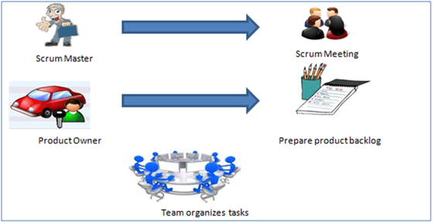
Roles in SCRUM
Scrum Master
Master is responsible for setting up the team, sprint meeting and removes obstacles to progress
Product owner
The Product Owner creates product backlog, prioritizes the backlog and is responsible for the delivery of the functionality at each iteration
Scrum Team
Team manages its own work and organizes the work to complete the sprint or cycle

Slide 13
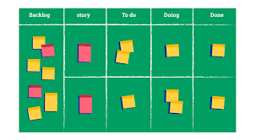

Slide 14
SCRUM PHASES - First Phase
The first phase is the pregame phase which deals with the planning and architecture of the project.
The planning is done with the creation of the backlog and list of activities that must be done for breaking down the epics into smaller user stories to make the product backlog. Also, the user stories are made into tasks in the sprint backlog stage.
Next is the Architecture or high-level design. Here most of the actual work in the sprint backlog is decided. The work that is accomplished is how to work on the tasks, make changes if required, refine the tasks, do analysis, and solve issues or problems that appear in the processes.

Slide 15
SECOND Phase
The game phase is the second phase in the scrum phases.
It is where the actual work is accomplished. Here each task assigned to the resource is started and completed with the definition of done. There 4 steps to accomplish the tasks,
Develop the sprint backlog and then start the development, testing and documenting changes, etc
Close the work status
Conduct review meetings
Make the changes required for the definition of the done.
Here in this phase at the beginning, there will be a stand-up meeting and every team member must attend this meeting. After the planning phase when the development starts there might be issues or problems that need to be solved, or so the scrum master or the product owner will stop the sprint and accommodate the changes and then restart the sprint newly.
The team members at the end of every sprint must do the following,
Actualize a burndown chart
Take part in the sprint review meeting
Finally, take part in the retrospective meeting

Slide 16
THIRD Phase
The post-game phase is the last in the scrum phases.
The development phase is ended and the products are prepared for the release. All the necessary steps such as testing, integration, training, user documentation, and marketing materials are released.
As you see the scrum is more time-oriented than the other methods. The people do not waste time as time is very important.

Slide 17
extreme Programming (XP)
Extreme Programming technique is very helpful when there is constantly changing demands or requirements from the customers or when they are not sure about the functionality of the system. It advocates frequent "releases" of the product in short development cycles, which inherently improves the productivity of the system and also introduces a checkpoint where any customer requirements can be easily implemented. The XP develops software keeping customer in the target.
USER STORIES ,INDEX CARDS ,PRIORITIES,CRC

Slide 18
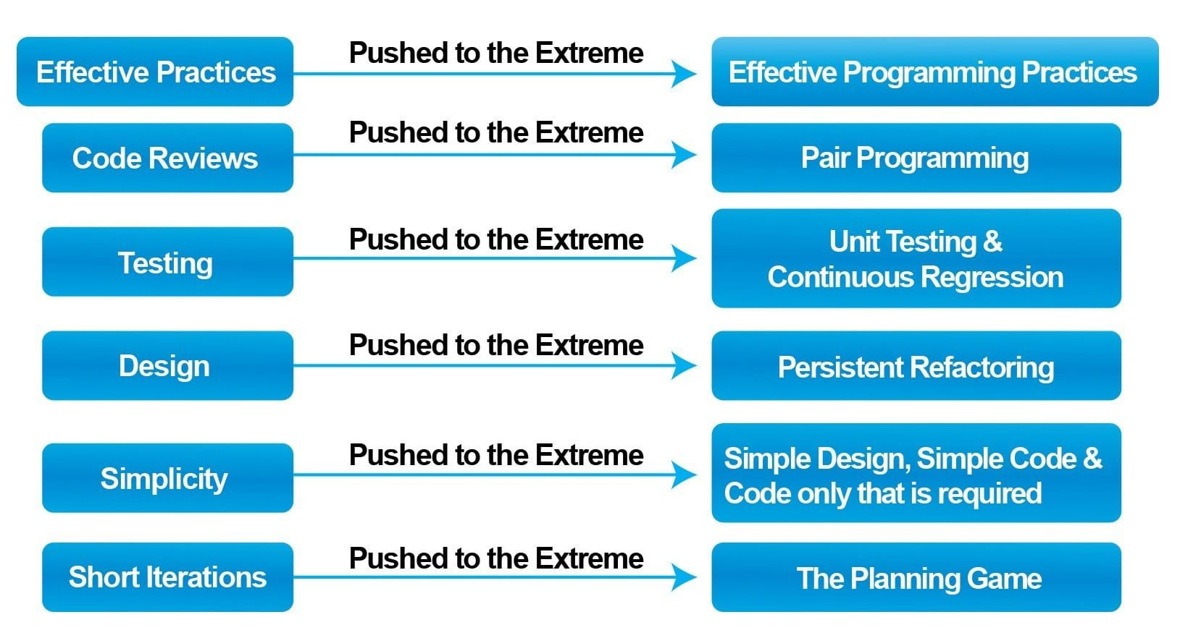
Extreme Programming The below figure shows us how the typical software development phases and values, have been pushed to their extreme level in this method of development.

Slide 19
Extreme Programming lightweight ,easy,reduce risk,efficient
Why is it called “Extreme?”
Firstly, reviewing the code at every step in every iteration to make it more effective
Secondly, by doing Regression testing at every stage of development to make testing more effective.
In addition to the above, daily re-using of codes makes the design more effective.
Moreover, short iterations make delivery more effective.

Slide 20
XP is one of the most popular methods. It is lightweight because
Firstly, it concentrates on getting more feedback, rather than asking customers upfront about what he wants.
Secondly, it delivers value to the customer in small iterations (1 or 2 weeks).
It encourages change. In other words, it tries to accommodate all the changes suggested by the customer feedback, then redesigns it, recodes it and retests it.
Moreover, it tries to eliminate defects at the early stages, therefore reducing rework and cost.
Keeps the customer involved throughout the project.

Slide 21
When to use Extreme Programming:
Extreme programming application happens in the projects where the requirements keep on changing.
In some critical projects, even before starting the project, the timelines are decided. It is referred to as project risk as it is challenging to meet those timelines. Therefore, Extreme programming also addresses the project risk by frequent and shorter development cycles and consequently enabling early feedback.
XP gets applied where we have a small group of programmers, not more than 12.
On the shorter cycles called Iterations with span of 14 days time period. Each iteration includes phases like coding, unit testing and system testing where at each phase some minor or major functionality will be built in the application.

Slide 22
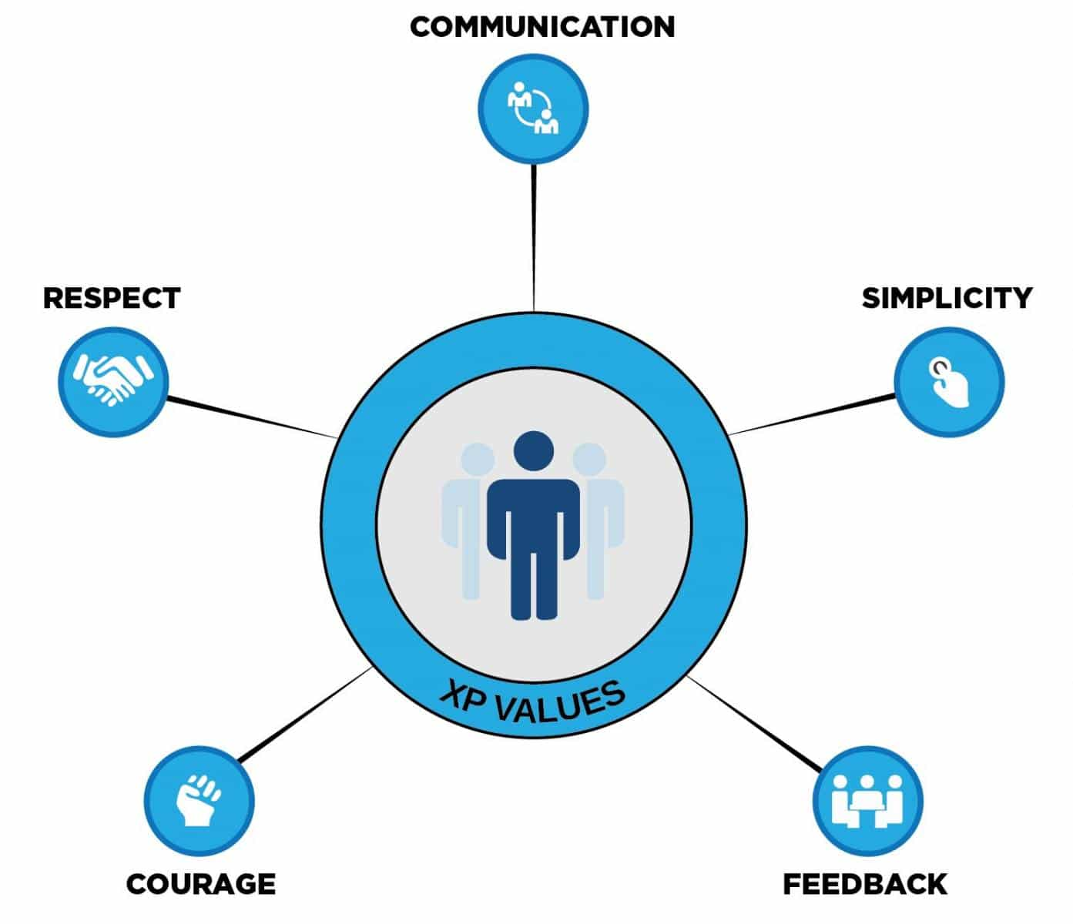
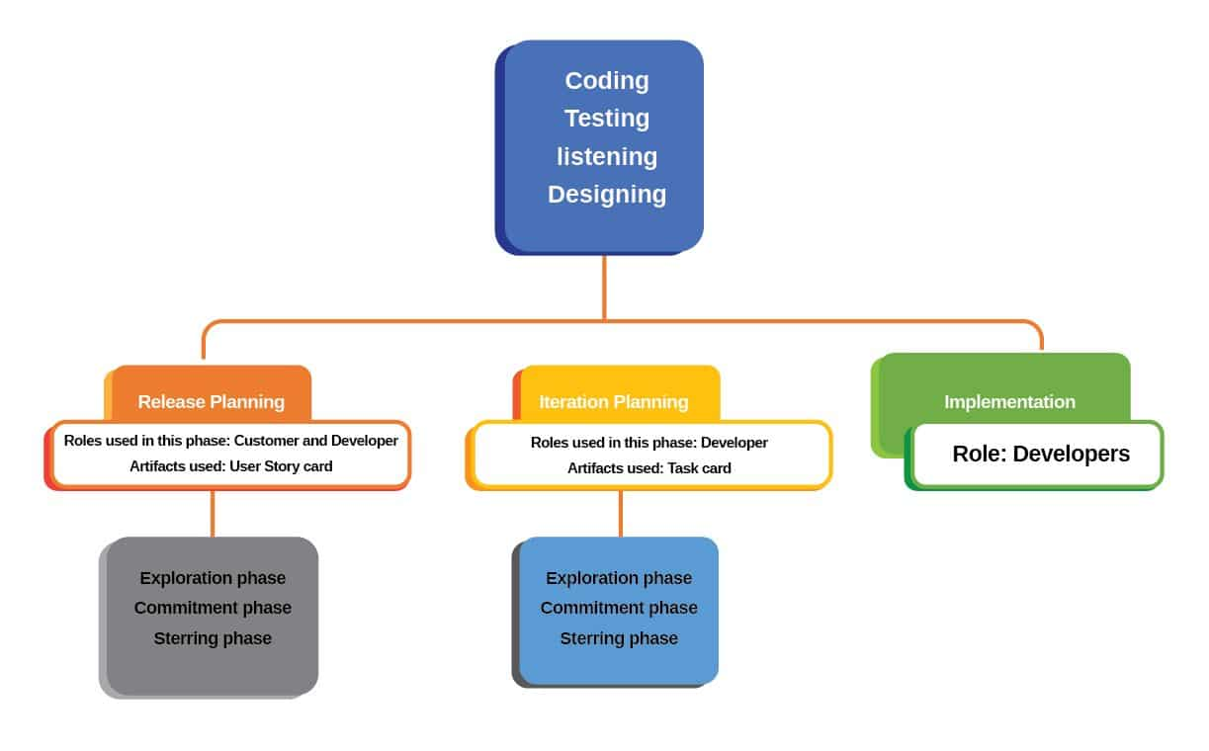
Values & Activities of Extreme Programming: What is Extreme Programming (XP) and its Principles & Practices? (toolsqa.com)

Slide 23

Feature Driven Development (FDD)
The five processes of FDD are: • Develop an overall model • Build a features list • Plan by feature • Design by feature • Build by feature

Slide 24
Agile Requirements
EPIC – An epic is a large user story that cannot be delivered as defined within a single iteration or is large enough that it can be split into smaller user stories
USER STORY -user story (short: story) is a collection of requirements that are detailed enough for Software Engineers to implement. Stories are a breakdown of the bigger scope of an epic.
TASK -A task, on the other hand, more a technical nature, Task is typically something like code this, design that, create test data for such-and-such, automate that, and so on. These tend to be things done by one person.
AS A <USER > I WANT TO <PERFORM TASK >SO THAT WE CAN <ACHIEVE GOAL>

Slide 25
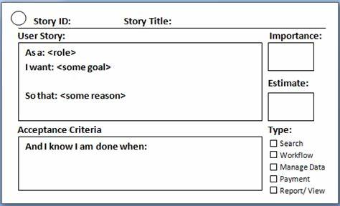
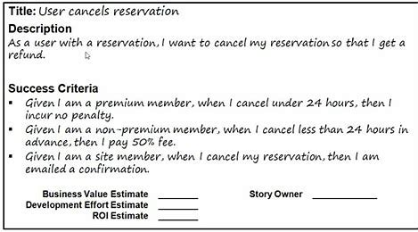
Index cards are an excellent tool to use to optimize communication
USER STORY

Slide 26
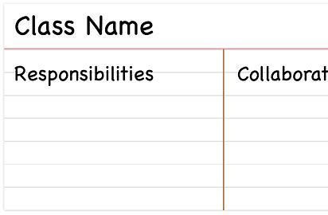
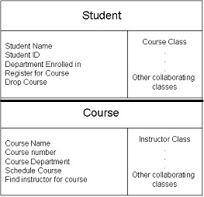
CRC [Class-responsibility-collaborator]
A brainstorming tool used in object oriented software in agile environment.
The cards are arranged to show the flow among the instances of each class.
It is a collection of standard index card that have been divided into 3 sections :-
1. A Class represents a collection of similar objects
2. A responsibility is something the class knows or does
3.A collaborator is another class that a class interacts with to fulfill its responsibilities.

Slide 27
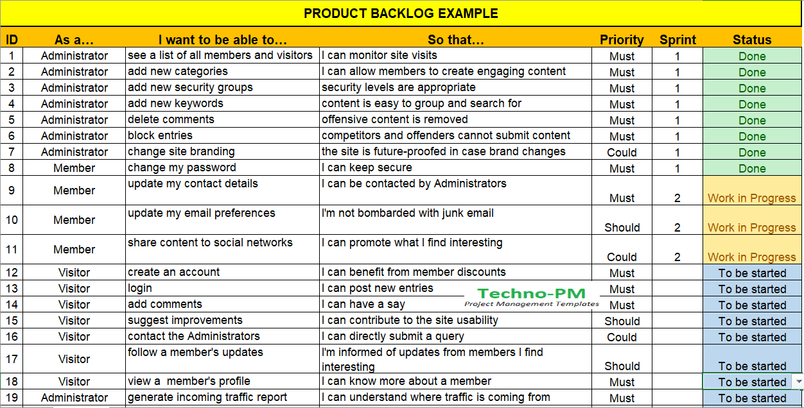
PRODUCT BACKLOG is a prioritized list of deliverables (such as new features) that should be implemented as part of a project or product development. It's a decision-making artifact that helps you estimate, refine, and prioritize everything you might sometime in the future want to complete.

